Slide 1
Genome inference in the age of noisy sequencers and intelligent machines
Erik Garrison
Wellcome Trust Sanger Institute
and Cambridge University
B@G⁴ Winter School, Weggis, CH
February 13, 2018

Slide 2
Overview
DNA variation and sequencing
Alignment to linear sequences
Error detection and genotyping
Genome variation graphs
Learning to genotype

Slide 3
Genomic variation

Slide 4
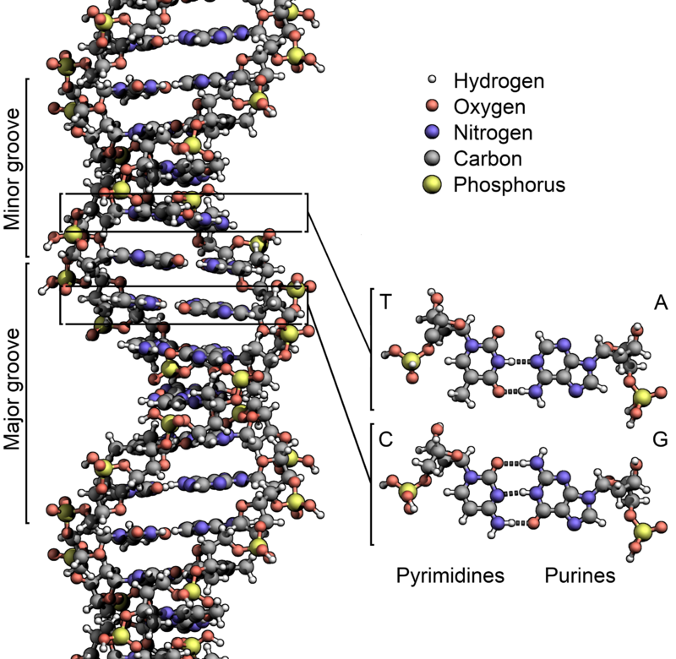
DNA

Slide 5
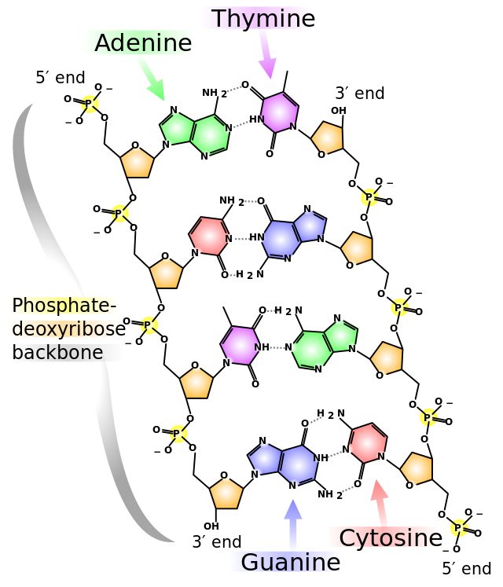
DNA
“twisted” view of ladder

Slide 6
A SNP
A point mutation in which one base is swapped for another.
AATTAGCCATTA
AATTAGTCATTA

Slide 7
An INDEL
A mutation that results from the gain or loss of sequence.
AATTAGCCATTA
AATTA--CATTA

Slide 8
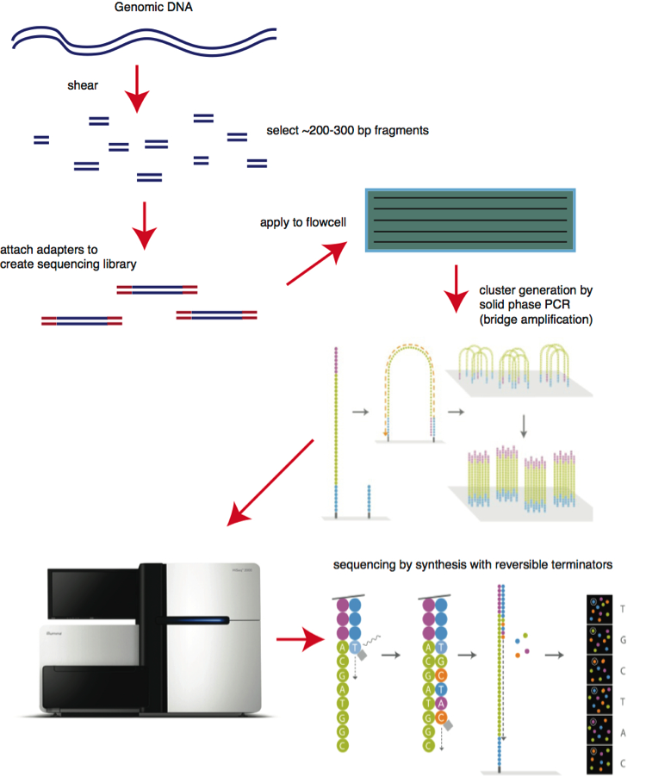
Sequencing
by synthesis (Illumina)
http://bitesizebio.com/13546/sequencing-by-synthesis-explaining-the-illumina-sequencing-technology/

Slide 9
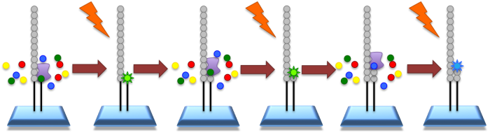
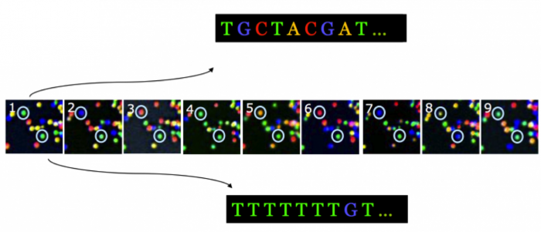
http://www.ebi.ac.uk/training/online/course/ebi-next-generation-sequencing-practical-course/what-next-generation-dna-sequencing/illumina-

Slide 10
What can go wrong?
Input artifacts, problems with library prep
replication in PCR has no error-correction (→ SNPs)
no quaternary structures (e.g. clamp) to prevent slippage (→ indels)
chimeras…
duplicates (worse if they are errors)
Sequencing-by-synthesis
phasing of step
synthesis reaction efficiency is not 100%
particularly bad in A/T homopolymers
certain context specific errors
vary by sequencing protocol, device
often strand-specific

Slide 11
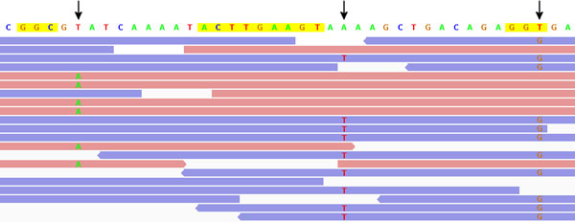
Example: Context specific errors
Show up as strand-specific errors:
http://www.ncbi.nlm.nih.gov/pmc/articles/PMC3622629/

Slide 12
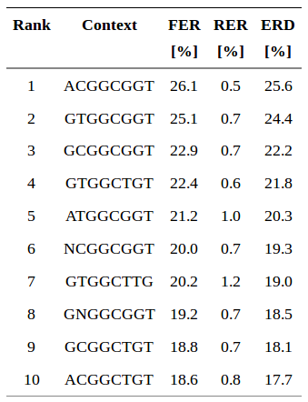
Context specific errors (motifs)
← forward and reverse error rates for the ten most-common CSEs on a variety of illumina systems
(often GC-rich)
http://www.ncbi.nlm.nih.gov/pmc/articles/PMC3622629/

Slide 13
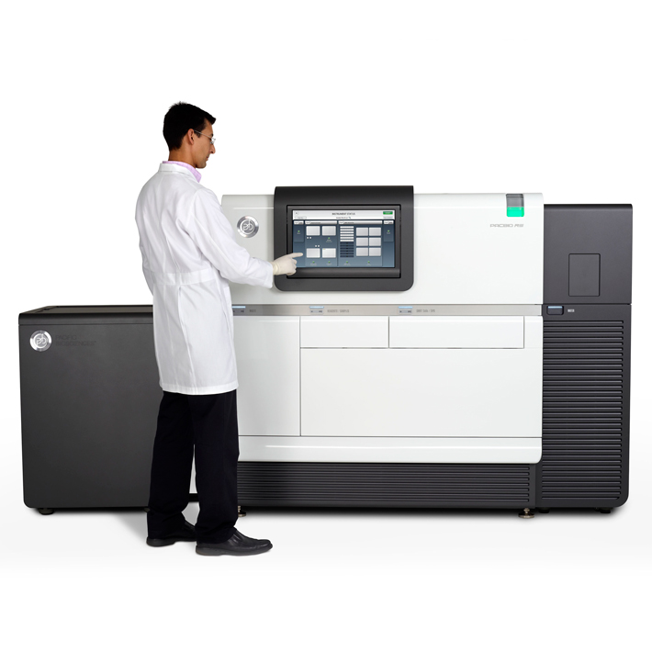
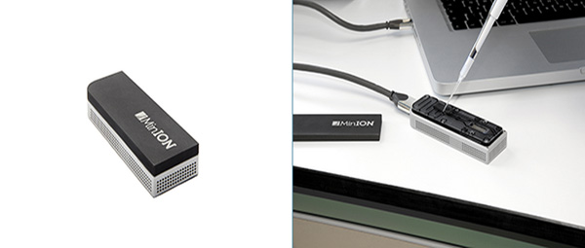
Long read technologies
“3rd-gen” sequencing.
Read single molecules (long too!)
Have high error rates (10-15%)
Pacific Biosciences
Oxford Nanopore

Slide 14
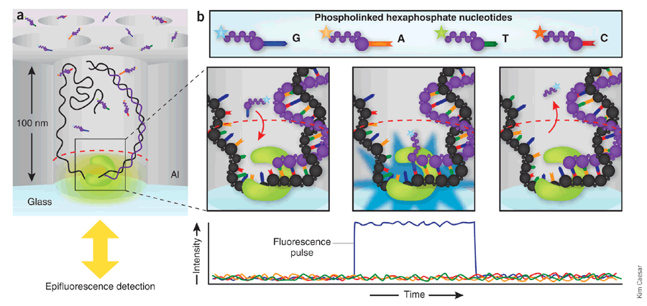
Pacific Biosciences sequencing

Slide 15
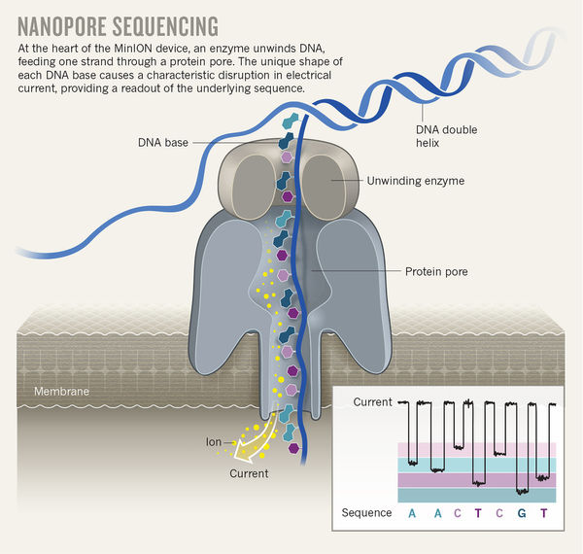
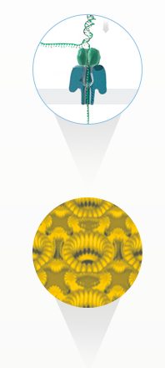
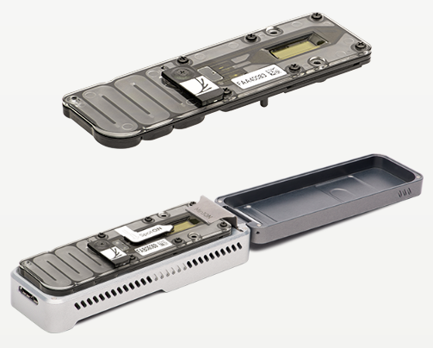
Oxford Nanopore sequencing

Slide 16
Alignment to linear genomes

Slide 17
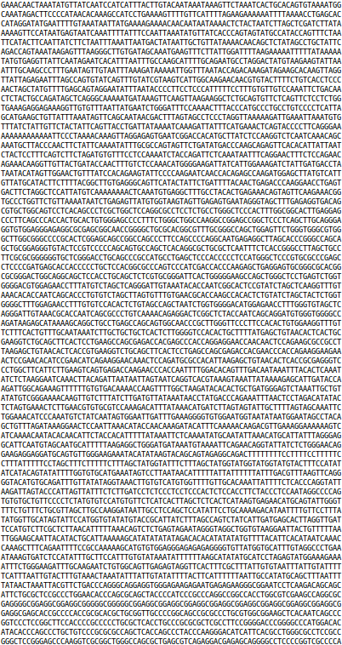
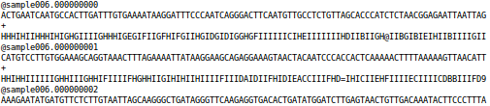
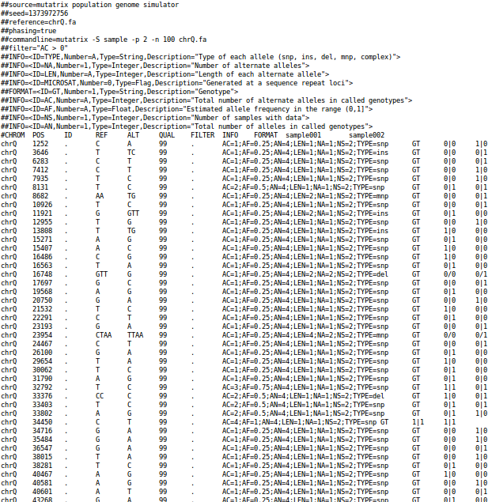
Objective: From reads to variants
Reads (FASTQ)
alignment and
variant calling
Genome (FASTA)
Variation (VCF)

Slide 18
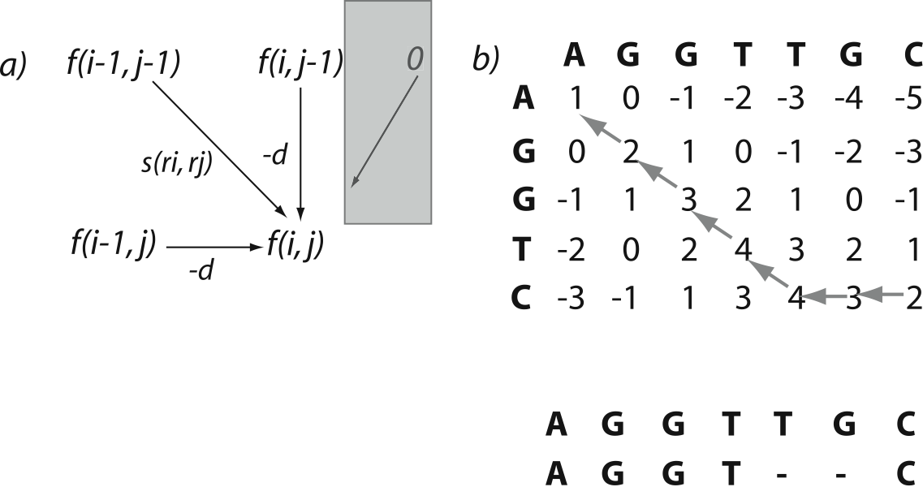
Pairwise alignment
Schematic of Needleman and Wunsch algorithm. Smith and Waterman bounds scores at 0, producing locally optimal alignments. http://www.hiv.lanl.gov/content/sequence/HIV/REVIEWS/2006_7/ABECASIS/abecasis.html

Slide 19
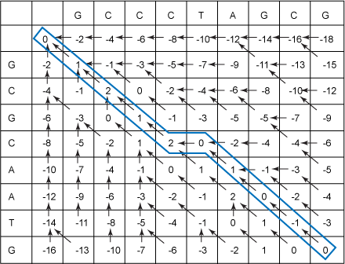
Needleman-Wunsch
Filled-in Needleman-Wunsch table with traceback
http://www.ibm.com/developerworks/library/j-seqalign/

Slide 20
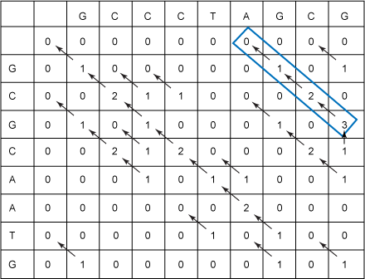
Smith-Waterman Gotoh
Filled-in SWG matrix with traceback
http://www.ibm.com/developerworks/library/j-seqalign/

Slide 21

Alignment against large genomes
Problem: genomes are big. Matching sequences by evaluating all possible alignments is too £¥€$
Idea: reduce the M in our O(NM) by finding a few candidate mappings quickly.
Solutions:
FM-index, kmer indexes, minimizer indexes

Slide 22
k-mer based alignment
Let’s break our reference genome(s) into sequences of a fixed size k.
Now we can make a (big) hash table:
k-mer → positions
and look for sequences of length k efficiently.

Slide 23
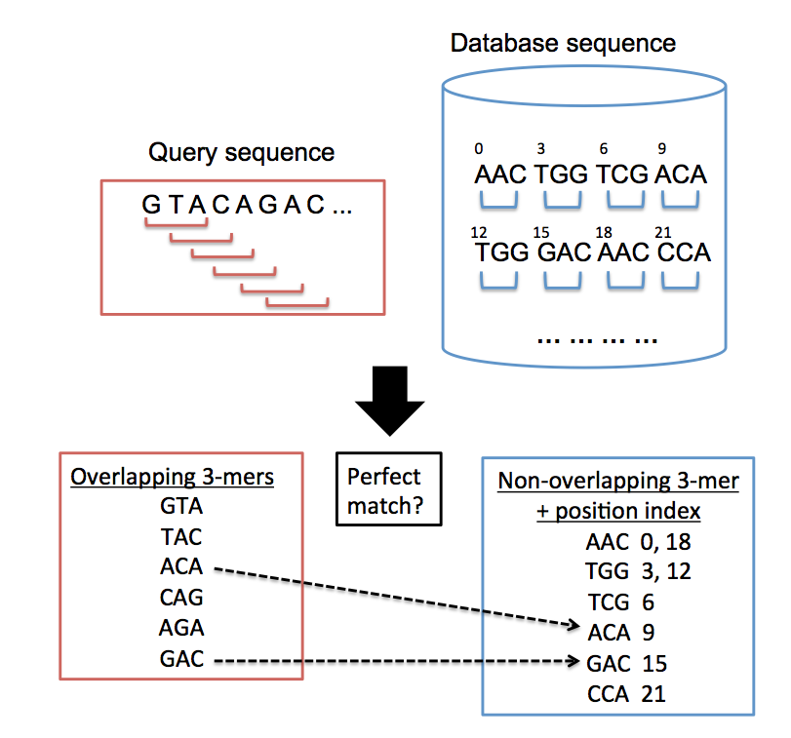
k-mer based mappers
Approach:
Make kmers in query, match to positions in database of kmers.
Use positional clustering to drive further alignment.
Implemented in:
BLAT (pictured), Mosaik, Novoalign, many projects.
https://en.wikipedia.org/wiki/BLAT_(bioinformatics)

Slide 24
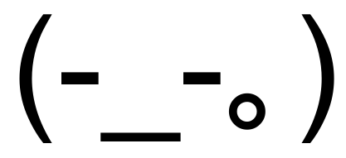

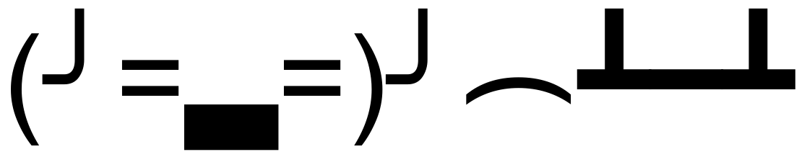
k-mer mapper limitations
If diversity between sample and genome or sequencing error rate is high enough, we lose many k-mer matches.
Short k-mers can be extremely redundant: What do we do with millions of hits?
k is a hard limit: Looking up long sequences requires stringing together many hits.

Slide 25
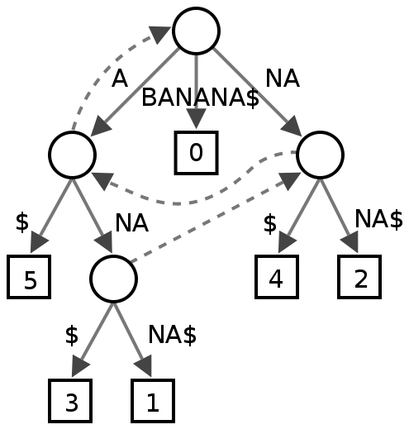
Suffix trees
A tree containing all suffixes of a string (here: BANANA) as paths from the root to the tree to the leaves.
We can look up any subsequence of the string in O(|subseq|) operations!
Problem: the tree requires a lot of memory! Practically, 10-20X the input text.
*Note that we use a sentinel character $ to indicate the end of the string. The dashed lines are suffix links, which are relevant for construction but not this presentation.
https://en.wikipedia.org/wiki/Suffix_tree

Slide 26
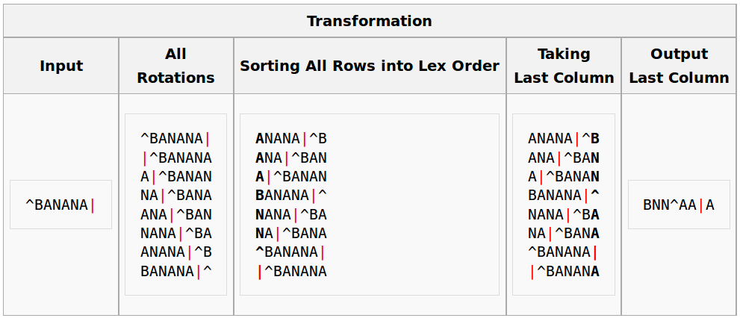
The FM-index
Suffix tree ~ Suffix array ~ BWT
BWT=Burrows-Wheeler transform
BWTs are highly compressible because they exploit repetitions in the text, but preserve the original sequence. Size: ~1X the input seq!
https://en.wikipedia.org/wiki/Burrows%E2%80%93Wheeler_transform

Slide 27
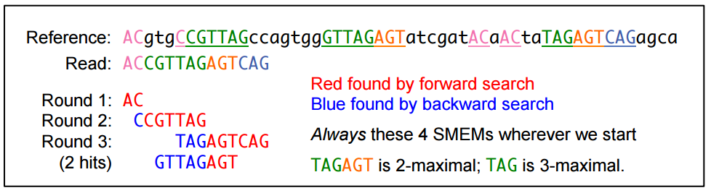
MEM mapping
Problem: can’t backtrack with high error rates, long reads
Solution: find MEMs using the FM-index (bwa mem)
Maximal exact match (MEM): an exact match that cannot be extended further in either direction.
Super-maximal exact match (SMEM): a MEM that is not contained in any other MEMs on the query coordinate (Li, 2012). At any query position, the longest exact match covering the position must be a SMEM.
http://lh3lh3.users.sourceforge.net/download/mem-poster.pdf

Slide 28
Minimizers
A (k,w)-minimizer is the “smallest” k-mer in a sequence w long. Consider (4,8)-minimizers of:
x = TTACTGGTCTG
def kmers(x, k): return [x[i:i+k] for i in range(len(x)-(k-1))]
# make all (4,8)-mers
[sorted(kmers(y, 4)) for y in kmers(x, 8)]
[['ACTG', 'CTGG', 'TACT', 'TGGT', 'TTAC'], ['ACTG', 'CTGG', 'GGTC', 'TACT', 'TGGT'], ['ACTG', 'CTGG', 'GGTC', 'GTCT', 'TGGT'], ['CTGG', 'GGTC', 'GTCT', 'TCTG', 'TGGT']]
# make (4,8)-minimizers [sorted(kmers(y, 4))[0] for y in kmers(x, 8)]
['ACTG', 'ACTG', 'ACTG', 'CTGG']

Slide 29
Benefits of minimizer indexes
K-mers are sampled sparsely, so we can save memory when storing the index.
Their sampling is structured, so we tend to get the same k-mer even in the presence of error.
This makes them useful for long, high-error reads from 3rd-gen sequencing tech, whole-genome alignment, and fast mapping.
Indexes are very fast to generate.
Alignment is very fast.
Implemented in minimap2.

Slide 30
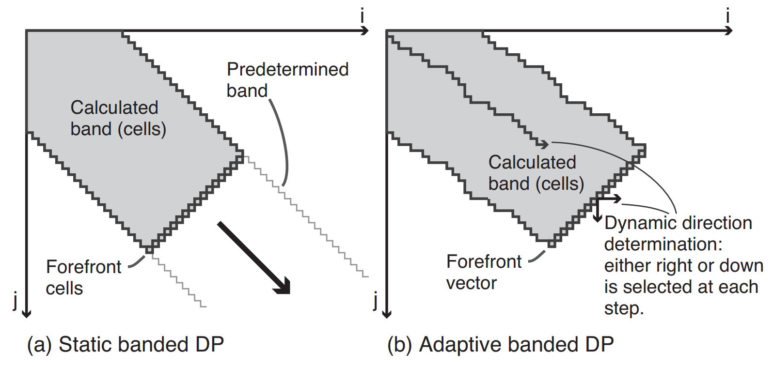
Adaptive banded alignment
Suzuki 2017. http://dx.doi.org/10.1101/130633

Slide 31
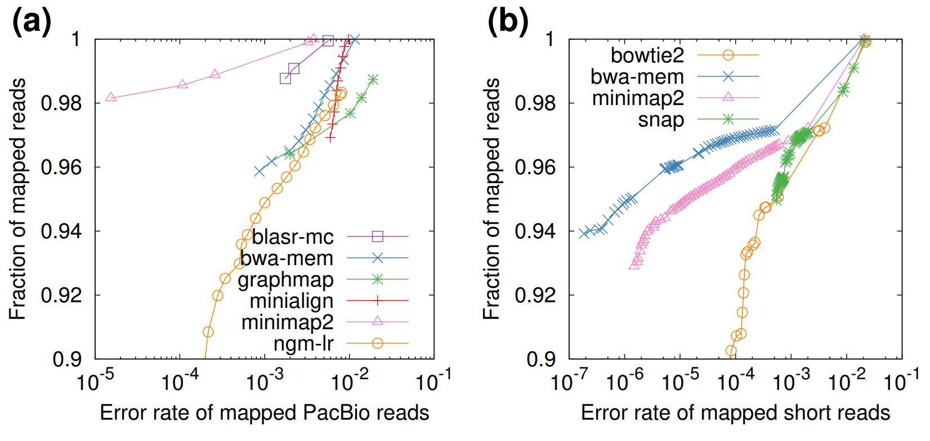
minimap2

Slide 32
Variant allele detection

Slide 33
Alignments to candidates
Reference
Reads
Variant observations
Notes:
*Small variant detection proceeds one position at a time. Multi-base alleles are brought into context at their leftmost position.
*Local phase is available in the reads, but is lost.

Slide 34
The data exposed to the caller
Reference
Notes:
*Small variant detection proceeds one position at a time. Multi-base alleles are brought into context at their leftmost position.
*Local phase is available in the reads, but is lost.

Slide 35
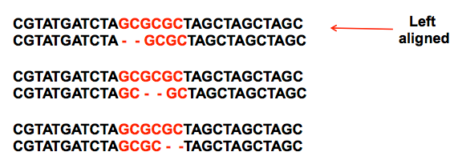
INDELs have multiple representations and require normalization for standard calling
Left alignment allows us to ensure that our representation is consistent across alignments and also variant calls.
https://www.biostars.org/p/66843/ user sa9

Slide 36
Direct detection of haplotypes
Reference
Reads
Direct detection of haplotypes from reads resolves differentially-represented alleles (as the sequence is compared, not the alignment).
Allele detection is still alignment-driven.
Detection window
Notes:
Anchoring reference-matching sequence is used to bound a reference-free haplotype detection window in which haplotype sequences are directly compared.
A detection window is determined dynamically by establishing the longest allele (wrt the reference).

Slide 37
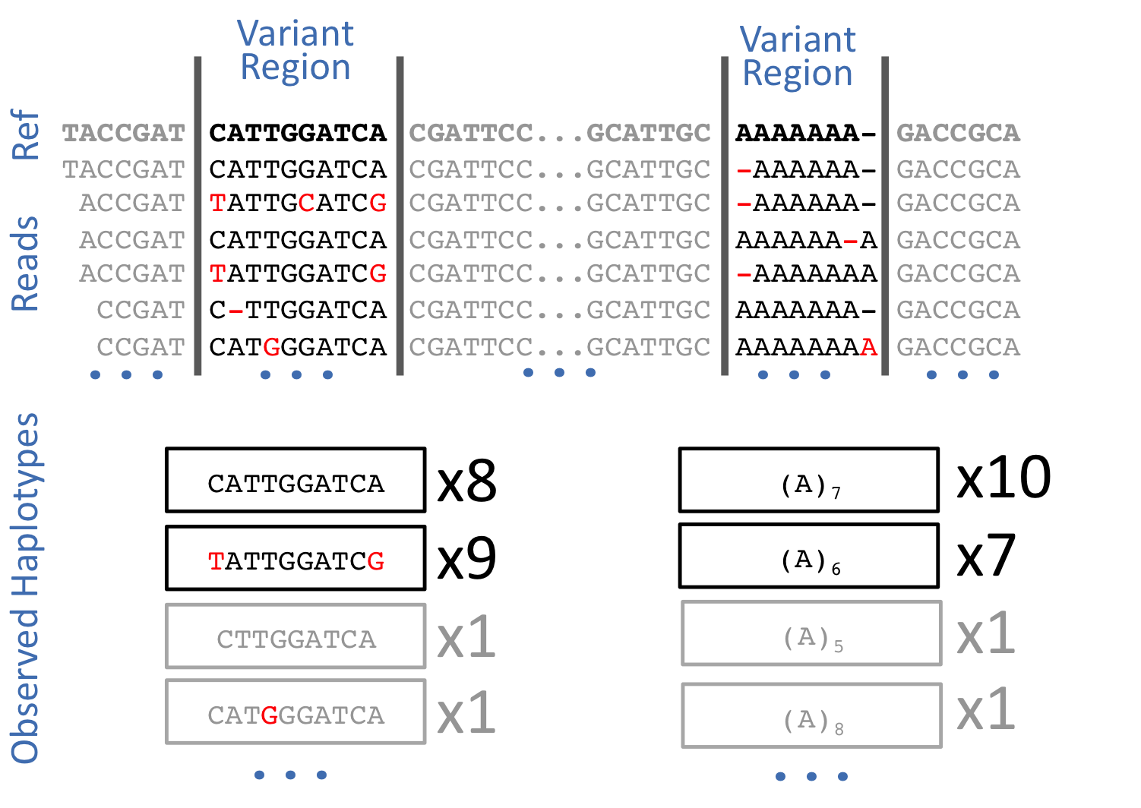

Slide 38
Genotyping and error detection

Slide 39
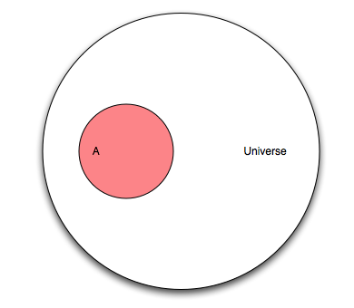
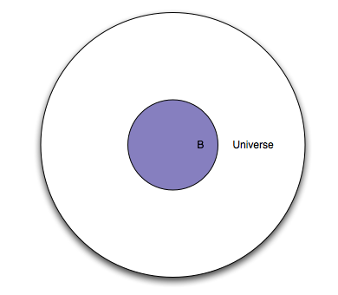
Bayesian (visual) intuition
We have a universe of individuals.
A = samples with a variant at some locus
B = putative observations of variant at some locus
Figures from http://oscarbonilla.com/2009/05/visualizing-bayes-theorem/

Slide 40
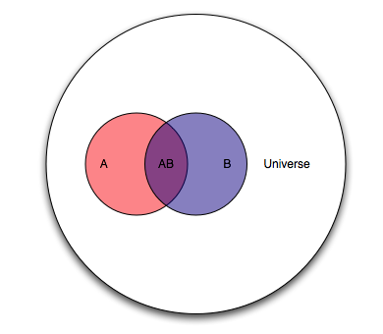
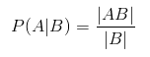
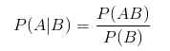
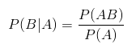
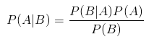
probability(A|B)
We want to estimate the probability that we have a real polymorphism "A" given "|" that we observed variants in our alignments "B".

Slide 41
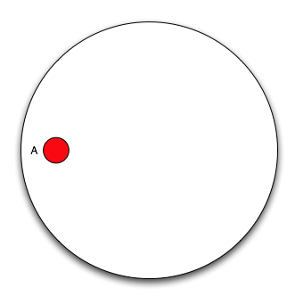
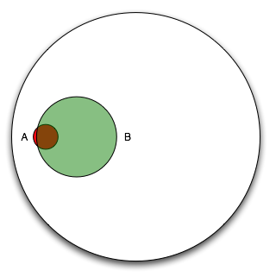
In our case it's a bit more like this...
Observations (B) provide pretty good sensitivity, but poor specificity.

Slide 42
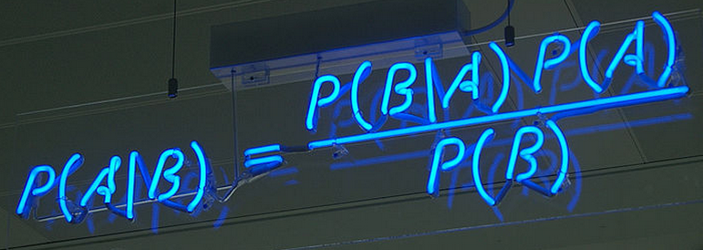
The model
Bayesian model estimates the probability of polymorphism at a locus given input data and the population mutation rate (~pairwise heterozygosity) and assumption of “neutrality” (random mating).
Following Bayes theorem, the probability of a specific set of genotypes over some number of samples is:
P(G|R) = ( P(R|G) P(G) ) / P(R)
Which in FreeBayes we extend to:
P(G,S|R) = ( P(R|G,S) P(G)P(S) ) / P(R)
G = genotypes, R = reads, S = locus is well-characterized/mapped
P(R|G,S) is our data likelihood, P(G) is our prior estimate of the genotypes, P(S) is our prior estimate of the mappability of the locus, P(R) is a normalizer.

Slide 43
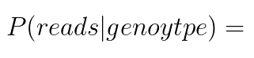
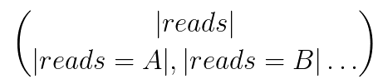
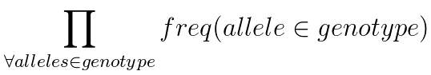
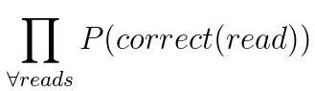
Handling non-biallelic/diploid cases
We compose our data likelihoods, P(Reads|Genotype) using a discrete multinomial sampling probability:
X
X
Our priors, P(Genoypes), follow the Ewens Sampling Formula and the discrete sampling probability for genotypes.

Slide 44
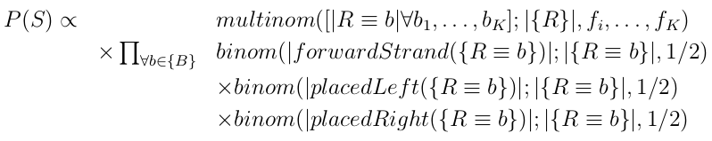
Are our locus and alleles sequenceable?
In WGS, biases in the way we observe an allele (placement, position, strand, cycle, or balance in heterozygotes) are often correlated with error. We include this in our posterior P(G,S|R), and to do so we need an estimator of P(S).
neutral
strand bias
cycle bias
placement bias
allele imbalance

Slide 45
The detection process
position
candidates
position
alignments
haplotypes
position
bayesian
model
sample posterior space
position
genotype likelihoods
position
find maximum
a posteriori genotyping
position
output record

Slide 46
Variant detector lineage
PolyBayes– original Bayesian variant detector (Gabor Marth, 1999); written in perl
GigaBayes– ported to C++
BamBayes– “modern” formats (BAM)
FreeBayes– 2010-present

Slide 47
FreeBayes-specific developments
FreeBayes model features (~in order of introduction):
Multiple alleles
Indels, SNPs, MNPs, complex alleles
Local copy number variation (e.g. sex chromosomes)
Global copy-number variation (e.g. species-level, genome ploidy)
Pooled detection, both discrete and continuous
Many, many samples (>30k exome-depth samples)
Genotyping using known alleles (hints, haplotypes, or alleles)
Genotyping using a reference panel of genotype likelihoods
Direct detection of haplotypes from short-read sequencing
Haplotype-based consensus generation (clumping)
Allele-length-specific mapping bias
Contamination-aware genotype likelihoods

Slide 48
Genome variation graphs

Slide 49
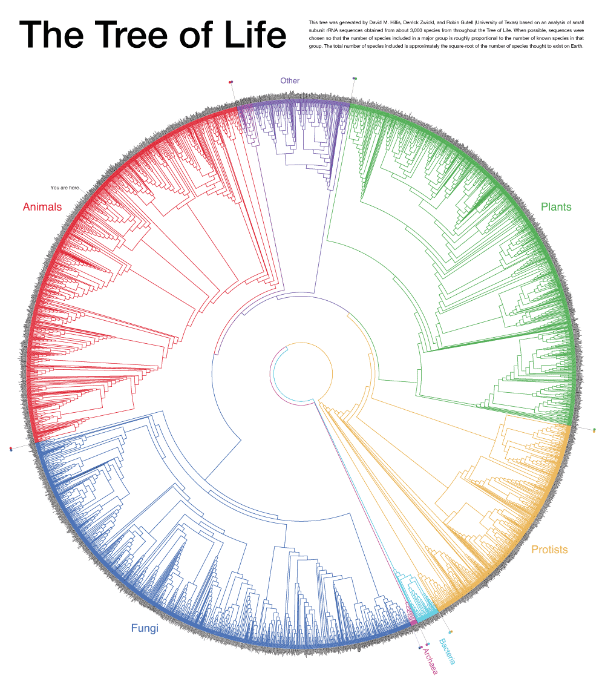

Slide 50
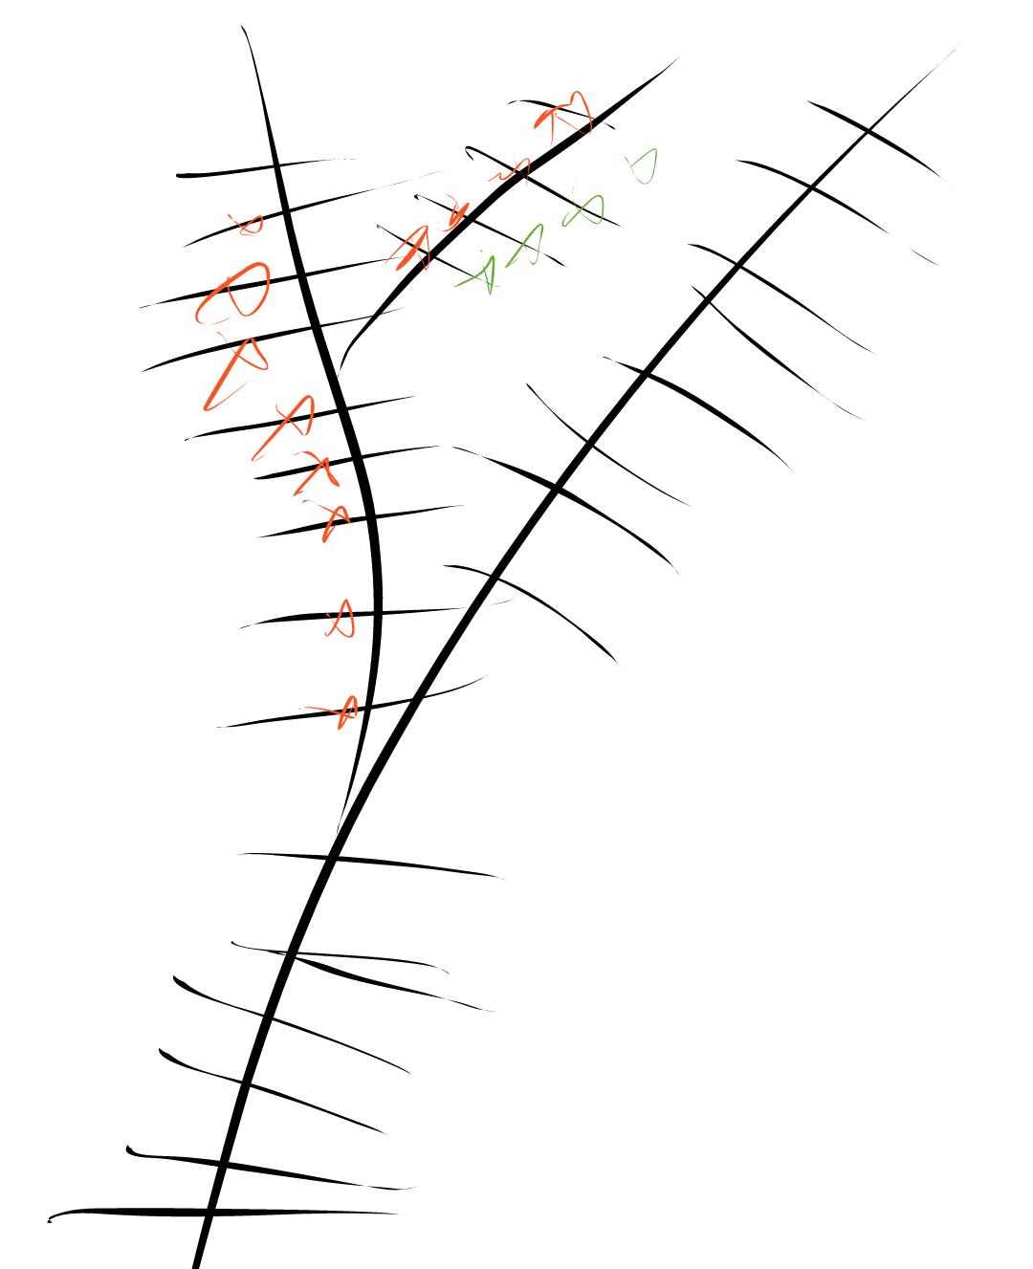
generations
variation
genomes

Slide 51
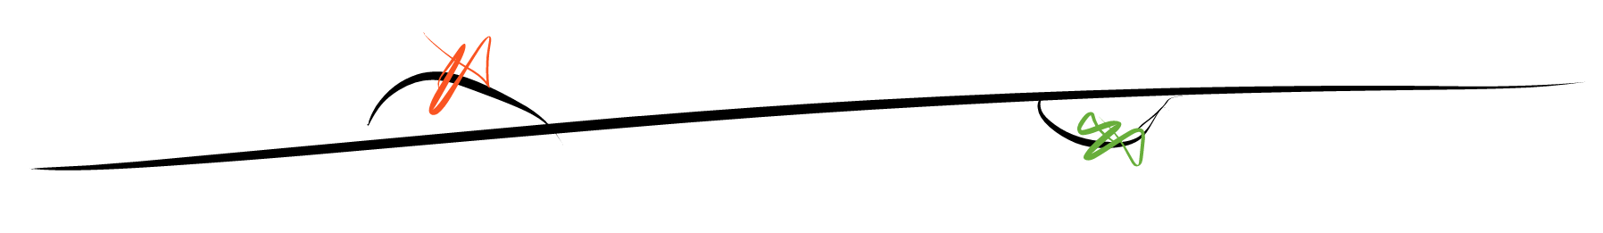
reference genome
generations
variation
genomes

Slide 52
generations
genome graph
variation
genomes

Slide 53
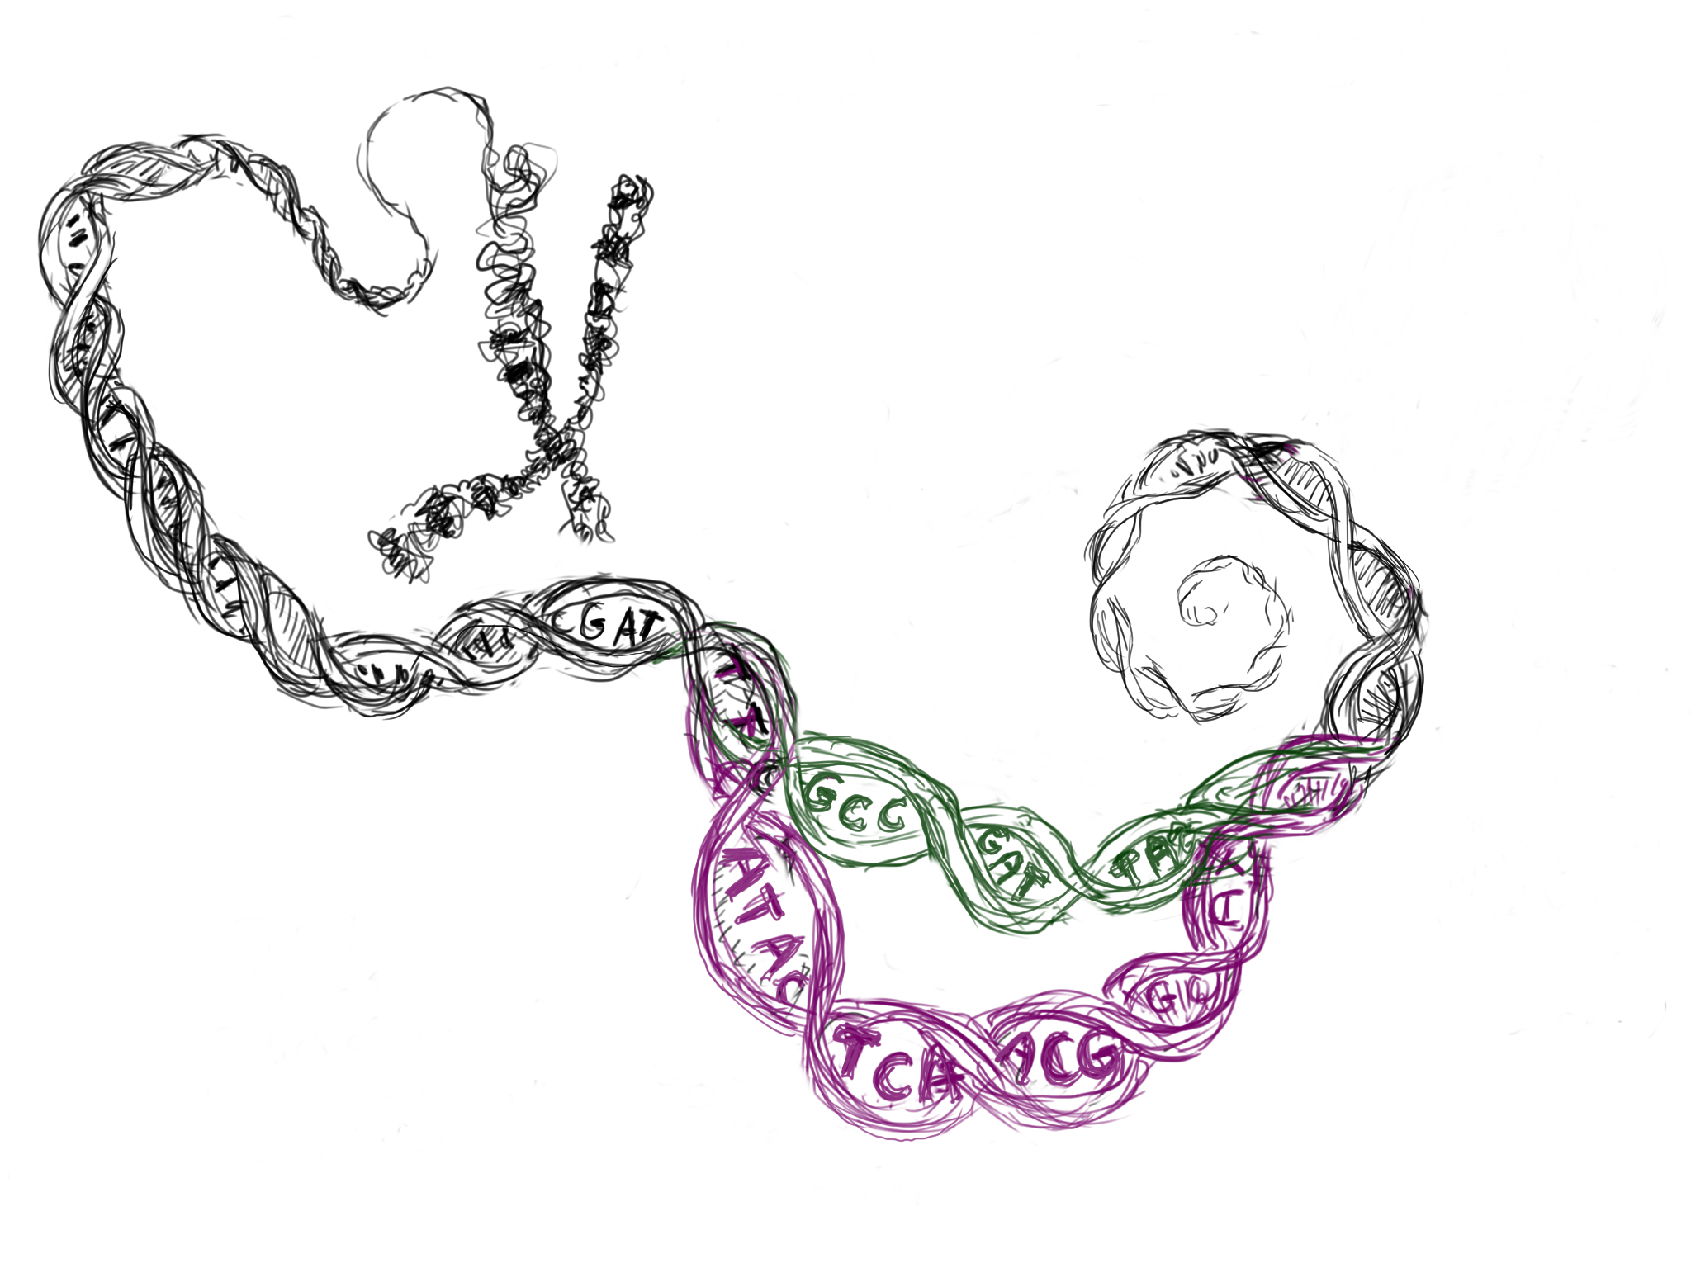
We want a model that looks like DNA, but represents many genomes at the same time.
Maciej Smuga-Otto http://www.smuga-otto.com/mso/

Slide 54
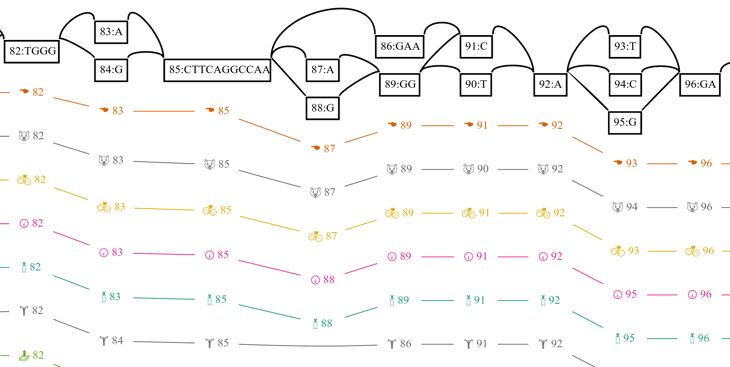
Variation graph

Slide 55
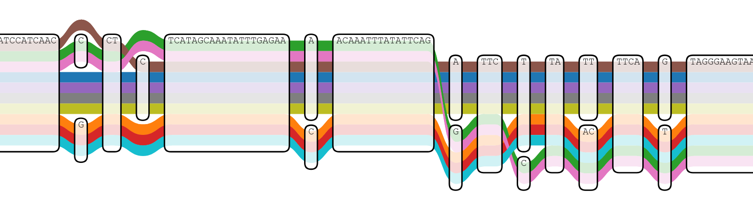
Variation graph
https://vgteam.github.io/sequenceTubeMap/

Slide 56


Slide 57


Slide 58


Slide 59


Slide 60


github.com/vgteam/vg

Slide 61


When does a linear reference fail?
raw alignments
realign to:
realigned to variation graph

Slide 62

Construction
(from VCF)
POS ID REF ALT
...
For each variant
cut the reference path around the variant
add the novel (ALT) sequence to the graph

Slide 63

Construction
(from VCF)
POS ID REF ALT
10 . A T
...
For each variant
cut the reference path around the variant
add the novel (ALT) sequence to the graph

Slide 64

Construction
(from VCF)
POS ID REF ALT
10 . A T
21 . A ATTAAGA
...
For each variant
cut the reference path around the variant
add the novel (ALT) sequence to the graph

Slide 65

Construction
(from VCF)
POS ID REF ALT
10 . A T
21 . A ATTAAGA
31 . TCTTT T
For each variant
cut the reference path around the variant
add the novel (ALT) sequence to the graph

Slide 66


Local alignment to the graph
T A A C 0 0 0 A 0 2 2 A 3 2 4 A 4 5 4 T 6 3 3 T 4 4 1 C 2 2 2 T 2 0 0
query:
CAAATTCT
C A A C 2 0 0 A 0 4 2 A 0 2 6 A 0 2 4 T 0 0 2 T 0 0 1 C 2 0 0 T 0 0 0
C T G C 2 0 0 A 0 0 0 A 1 0 0 A 2 0 0 T 2 4 1 T 5 4 3 C 10 7 6 T 7 12 9
G T T C 0 0 0 A 0 0 0 A 3 2 1 A 4 1 0 T 2 6 3 T 0 4 8 C 0 2 5 T 0 2 4
scores:
match = 2
mismatch = 2
gap_open = 3
gap_extension = 1
fill the score matrixes
find the maximum score
trace back for alignment

Slide 67
SMEMs in vg
By including an LCP array, we can find SMEMs in a linear scan through the sequence in the same way as we do with linear references.
vg find -M ACCGTTAGAGTCAG -g h.gcsa [["ACC",["1:-32"]],["CCGTTAG",["1:5"]],["GTTAGAGT",["1:19"]],["TAGAGTCAG",["1:40"]]]
ACGTGCCGTTAGCCAGTGGGTTAGAGTATCGATACAACTATAGAGTCAGAGCA
ACCGTTAGAGTCAG ACC CCGTTAG GTTAGAGT TAGAGTCAG
Sketch: backward search until we no longer match. Then execute parent() on the suffix tree node corresponding last non-empty BWT range to get a new range. Then continue backward searching to find the next SMEM.

Slide 68



A human pangenome
from 5000 haplotypes
The 1000G phase 3 release encodes ~80M variants. We build a graph from it + the GRCh37 reference, and then index this for mapping (~70G total).

Slide 69

ROC of reads simulated from NA24385’s haplotypes
We simulate reads from the parentally-phased haplotypes of NA24385 (HG002), for which we have a “truth set” established by the NIST Genome in a Bottle project.
We then map the simulated reads using several different reference systems:
GRCh37 (using bwa mem)
GRCh37 (using vg)
1000G pangenome (using vg)

Slide 70
ROC of reads simulated from NA24385’s haplotypes

Slide 71

Allele observation bias in real NA24385 data
At “true” heterozygous variants in NA24385, we count how many reads map to the reference and to the alternate over various allele lengths. We see no bias when mapping to allels in the 1000G graph.

Slide 72

Ancient DNA: high error and short reads
DNA degradation results in extremely high error rates in the tails of reads, which are often used by aligners to improve performance. This hurts alignment performance. Additional variants are hard to observe and we see profound levels of reference bias in aDNA samples.
https://ginolhac.github.io/mapDamage/

Slide 73

Simulated ancient DNA (vg vs. bwa)
Sensitivity vs. damage
analysis by Eppie Jones

Slide 74
Simulated ancient DNA (vg vs. bwa)
Specificity vs. damage
analysis by Eppie Jones

Slide 75

Alignment to the 1000G graph reference can alleviate reference bias towards known alleles.

Slide 76

CHiP-seq
Computer and Statistical Analysis of Transcription Factor Binding and Chromatin Modifications by ChIP-seq via https://www.researchgate.net/figure/ChIP-seq-workflow-and-data-analysis_230871724

Slide 77

Reference observations at SNPs found in the 1000G and in this sample (via freebayes calls), bwa (y-axis) vs vg (x-axis)
36-base pair reads from an ENCODE sample with histone-targeting CHiP.

Slide 78

Alternate observations at SNPs found in the 1000G and in this sample (via freebayes calls), bwa (y-axis) vs vg (x-axis)
Note that we require at least one alternate observation to make a call.

Slide 79


Log-scaled histogram view of the previous plots, showing difference in counts between the freebayes calls on vg and bwa mappings.
The reference observation count is not significantly different than 0 (t=1.6917, p=0.09071).
Shift right in the second plot represents an improvement in alternate observations in the vg mappings.
The alternate observation count is significantly different than 0 (t=85.032, p<2.2e-16).

Slide 80

Yeast pangenome
A region of a yeast genome variation graph corresponding to the start of the subtelomeric region on the left arm of chromosome 9 in a multiple alignment of de novo assembled strains from Yue 2017.

Slide 81

Simulation from SK1 strain
We simulate reads from SK1, and then map them back to different versions of the pangenome.
The pangenome outperforms the linear reference (S288c), but graph complexity limits our overall performance.

Slide 82
Mapping real data to the yeast pangenome
Here we map data from 12 Cerevisiae strains against our yeast pangenome and a linear reference for S288c.
74.6% of reads map with equal scores to both the pangenome and linear references, 24.9% map better to the pangenome, and only 0.5% map better to the linear reference.

Slide 83
Variant calling on the graph
a
a
a
c
a
c
a
Sample graph
Read alignment
GAM format
from vg map
Variants
Augmented graph
Graph Pileup
VG pileup format
from vg pileup
VG format
from vg call
Glenn Hickey, Adam Novak, Benedict Paten, Mike Lin

Slide 84


Whole human genome analysis pipeline
We submitted the a whole human genome analysis using variation reference methods as part of the PrecisionFDA resequencing competition. (May 2016.)
We did not win... but we did get a star for:

Slide 85

Whole human genome analysis pipeline
We submitted the a whole human genome analysis using variation reference methods as part of the PrecisionFDA resequencing competition. (May 2016.)
We did not win... but we did get a star for:

Slide 86

A community evalution of reference graphs (in MHC)

Slide 87

https://www.biorxiv.org/content/early/2017/12/15/234856

Slide 88
Learning to genotype

Slide 89
We can learn to genotype
Bioinformaticians working with sequencing data can look at a visualization of alignments and make a good guess at the genotype.

Slide 90

“It looks wrong/right”

Slide 91
“It looks wrong/right”

Slide 92


Can machines learn to genotype?
Traditionally, we mix observations and a priori models using Bayesian statistics to find variants and estimate genotypes.
Thomas Bayes

Slide 93

Can machines learn to genotype?
But instead of building our prior from first principles, we could learn it (with machines).
Marvin Minsky

Slide 94

Variant calling is kind’ve a text classification problem

Slide 95

That’s good because in 2016 we have awesome tools for learning text classification
The Vowpal Wabbit
John Langford

Slide 96

And, we have good truth sets which we can use to train
NIST Genome in a Bottle

Slide 97


The Wabbit is hungry, the wabbit learns
17 '1_718555_T_C |ref 1G:1 2G:1 3T:1 ... 17 '1_720240_T_C |ref 1A:1 2G:1 3A:1 ... 17 '1_720797_G_A |ref 1T:1 2G:1 3A:1 ... 1 '1_721781_C_A |ref 1T:1 2T:1 3T:1 ... 17 '1_723798_CAG_C |ref 1A:1 2A:1 3G ... 1 '1_725504_T_A |ref 1G:1 2A:1 3T:1 ... 17 '1_726313_CGAATGGAATG_C |ref 1C:1 ... 17 '1_726481_T_G |ref 1G:1 2G:1 3G:1 ... 17 '1_728159_C_T |ref 1A:1 2G:1 3T:1 ... 17 '1_728242_C_G |ref 1A:1 2G:1 3T:1 ...
...
...
Training data:
lines labeled with genotype
NA12878 sequencing data →
bwa / freebayes / fermikit →
+ truth → vw input
Vowpal Wabbit
Classification model

Slide 98
The Wabbit labels new data
? '1_718555_T_C |ref 1G:1 2G:1 3T:1 ... ? '1_720240_T_C |ref 1A:1 2G:1 3A:1 ... ? '1_720797_G_A |ref 1T:1 2G:1 3A:1 ... ? '1_721781_C_A |ref 1T:1 2T:1 3T:1 ... ? '1_723798_CAG_C |ref 1A:1 2A:1 3G ... ? '1_725504_T_A |ref 1G:1 2A:1 3T:1 ... ? '1_726313_CGAATGGAATG_C |ref 1C:1 ... ? '1_726481_T_G |ref 1G:1 2G:1 3G:1 ... ? '1_728159_C_T |ref 1A:1 2G:1 3T:1 ... ? '1_728242_C_G |ref 1A:1 2G:1 3T:1 ...
...
...
Test data: unlabeled lines
Classification model
0/0, 0/0, 0/1, 0/0, 0/1, 0/0 …
Answers: genotypes for lines according to model

Slide 99

What features help us genotype?
*Trained on 3 runs of NA12878 at the Garvan Institute. Tested on another sample on held out regions which were not used in training.

Slide 100


HHGA is the best F/OSS method in
the PrecisionFDA
Truth Challenge
*
*hhga is the highest- performing free/open source method for both SNPs and indels.
The rest are GATK-derived or other proprietary methods.
*

Slide 101

DeepVariant
*winner of precisionFDA
dv42
https://www.biorxiv.org/content/early/2016/12/21/092890

Slide 102
Practicals

Slide 103
Practical
Walkthrough: https://github.com/ekg/alignment-and-variant-calling-tutorial#ngs-alignment-and-variant-calling

